Slide 1
United Nations
International Criminal Tribunal for the Former Yugoslavia
The Hague, the Netherlands

Slide 3
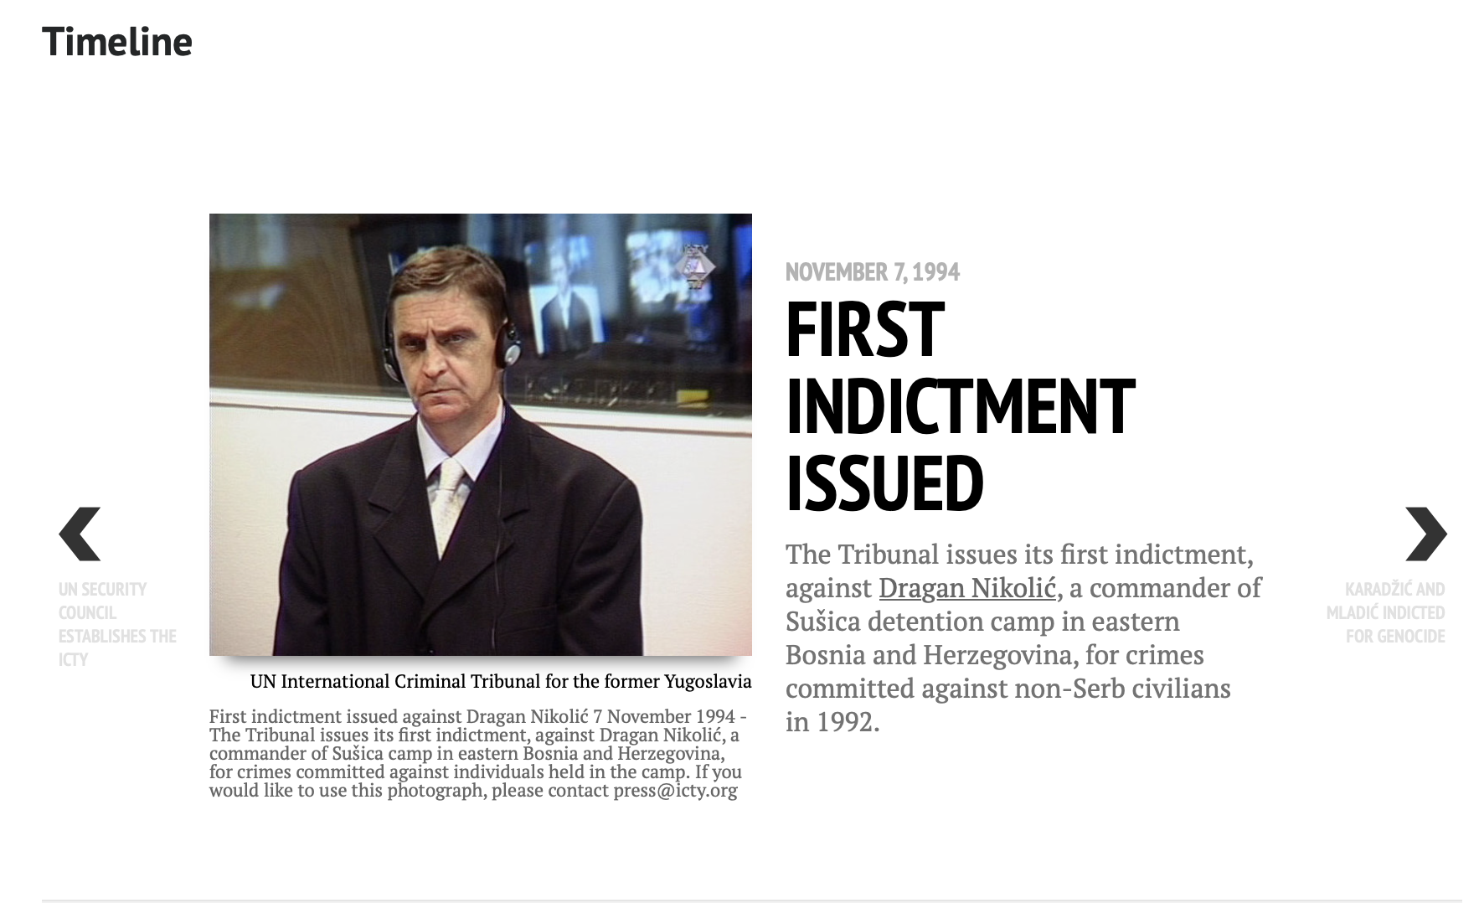

Slide 9
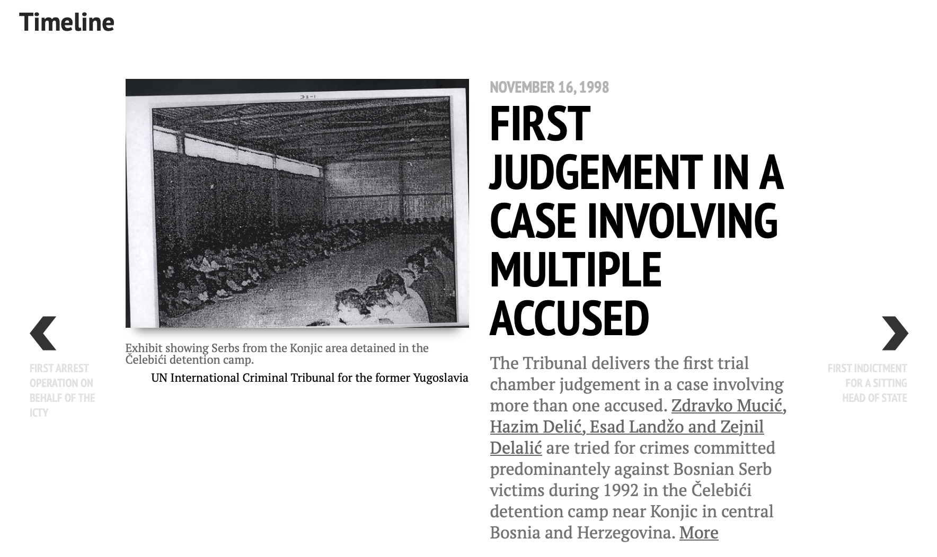

Slide 12
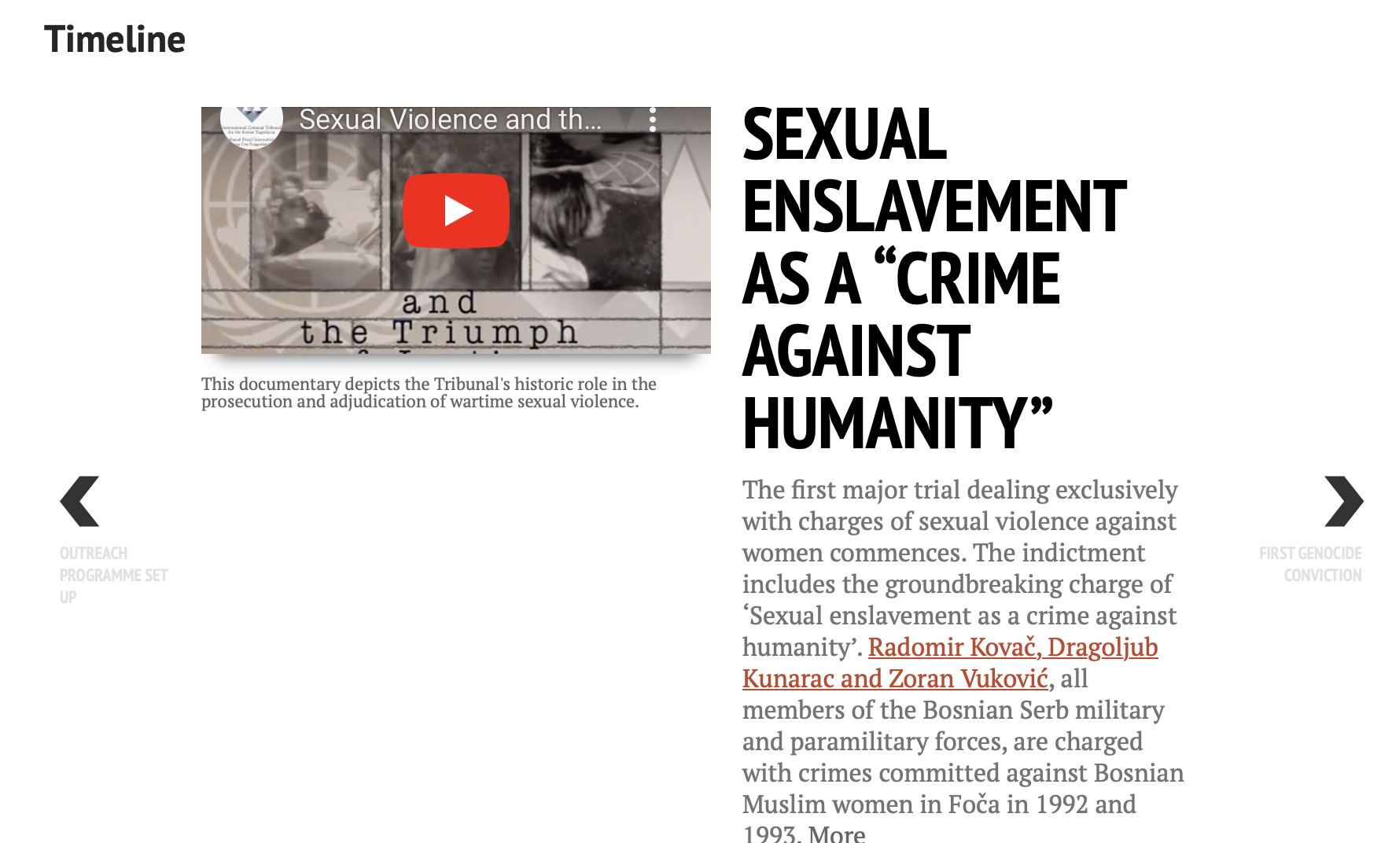

Slide 13
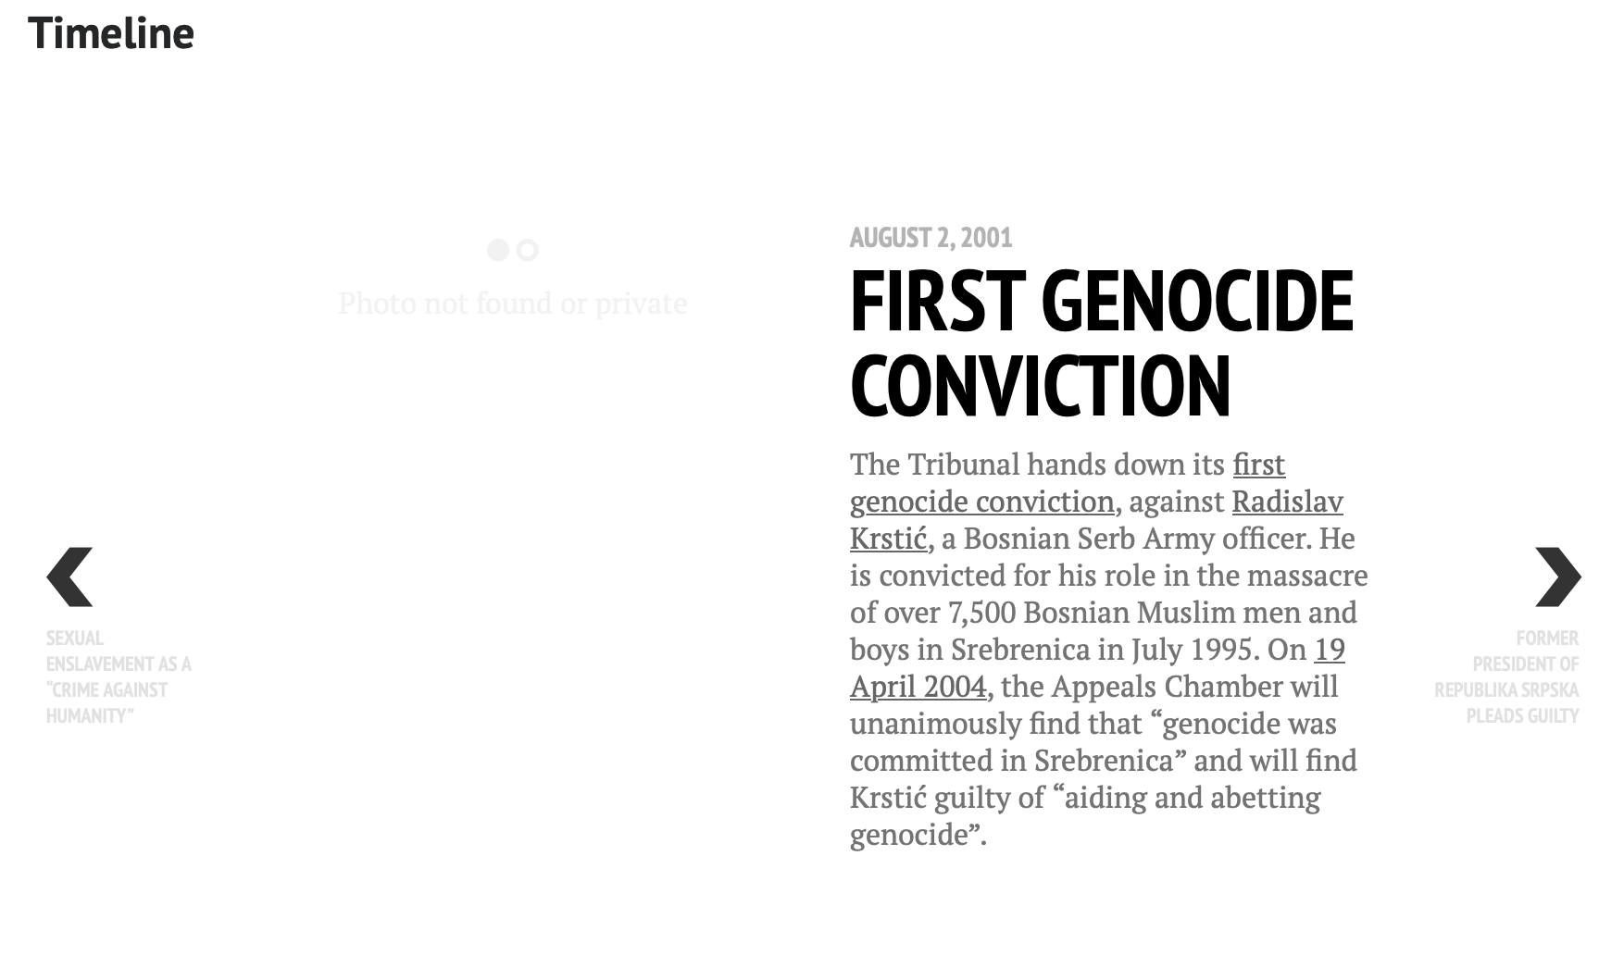

Slide 17
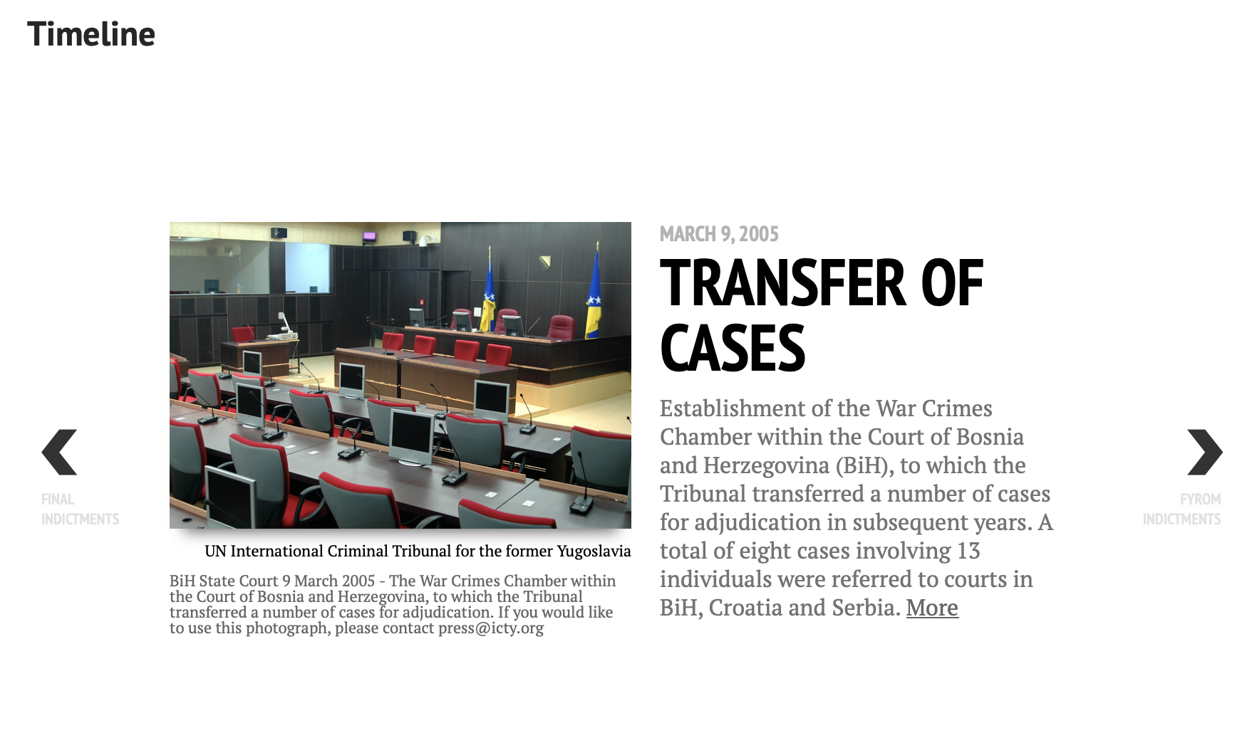

Slide 19
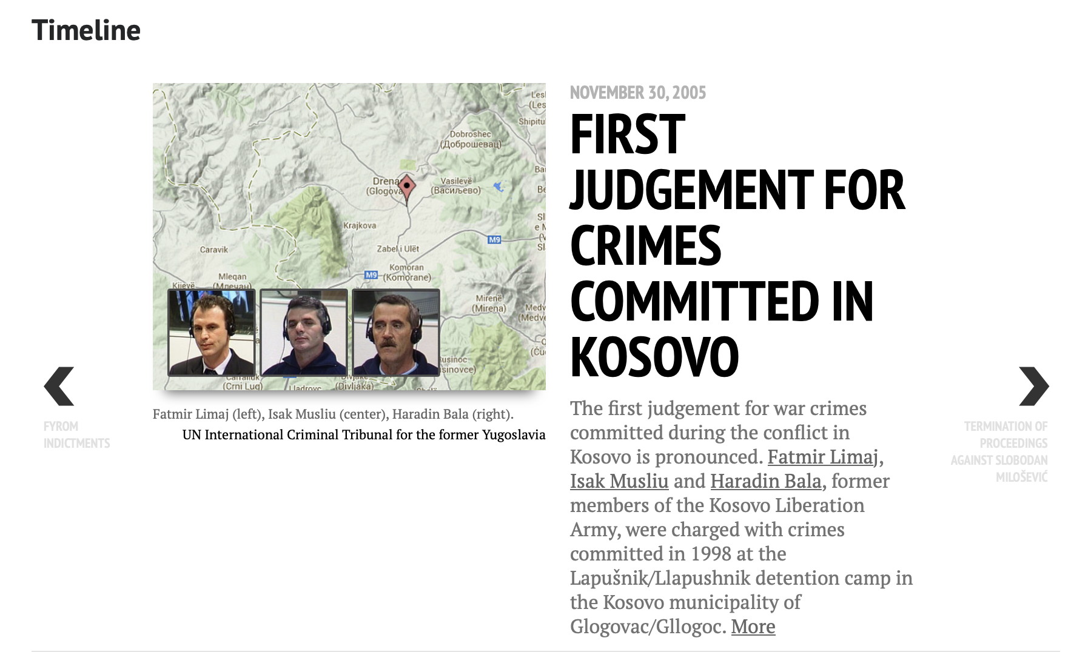

Slide 25
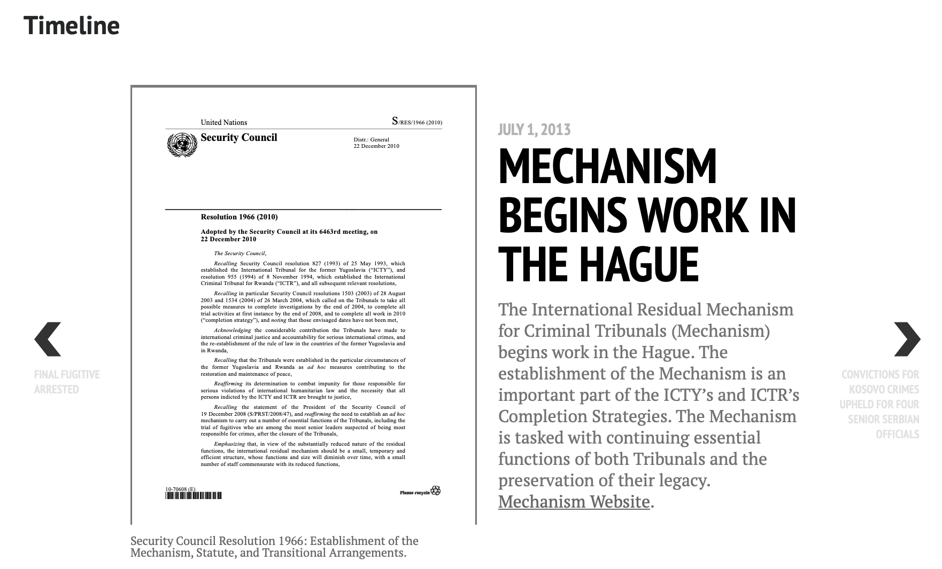

Slide 32
Source: https://www.icty.org/en/features/timeline

