Slide 1
International Criminal Court
The Hague, the Netherlands

Slide 2
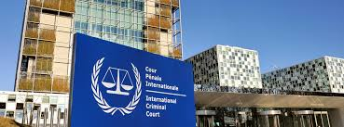
What does it do?
The International Criminal Court in The Hague prosecutes those accused of war crimes, crimes against humanity and genocide.

Slide 3
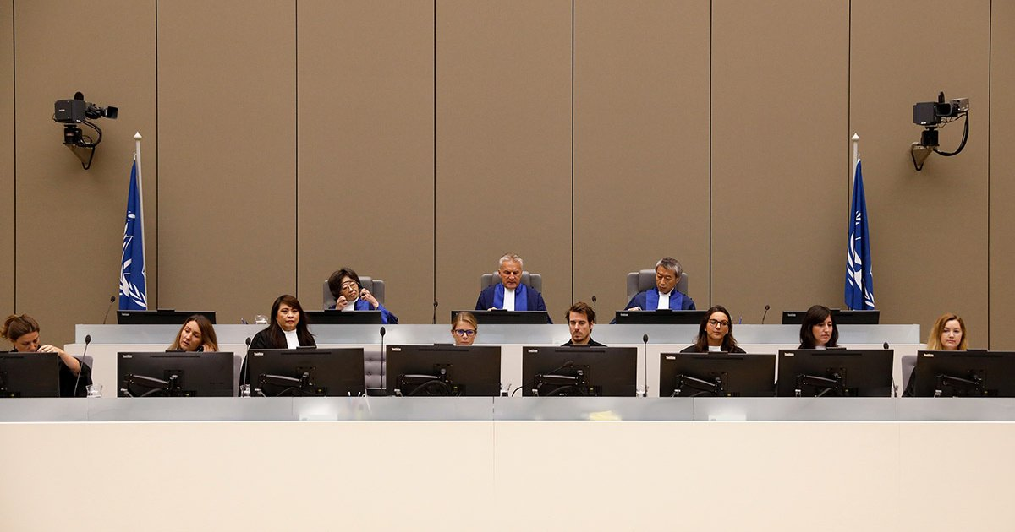
How was it established?
In 1998, 60 countries signed the Rome Statute after it was opened for signature by the United Nations. The Statute laid the foundation for the establishment of the International Criminal Court in 2002. Its purpose is to investigate and prosecute war criminals.

Slide 4
What are the crimes within the jurisdiction of the International Criminal Court?
War crimes
War crimes include torture, mutilation, corporal punishment, hostage taking and acts of terrorism. This category also covers violations of human dignity such as rape and forced prostitution, looting and execution without trial. War crimes, unlike crimes against humanity, are always committed in times of war.
Genocide
This includes all acts committed with the intent to destroy a national, ethnic or religious group.
Crimes against humanity
Crimes against humanity are acts committed as part of a widespread or systematic attack directed against any civilian population, such as murder, deportation, torture and rape. The ICC prosecutes the perpetrators even if the crimes were not committed in times of war.

Slide 5
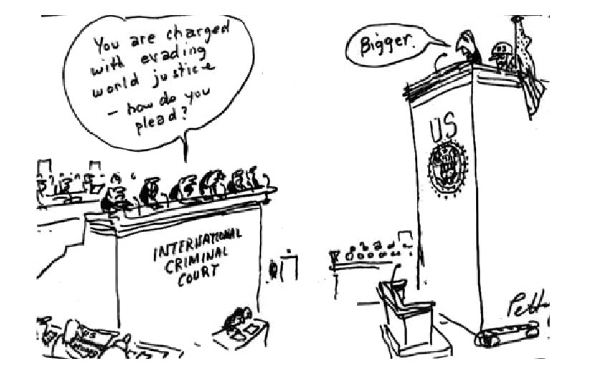
Does ICC punish crimes of aggression?
The states that are party to the Rome Statute have not yet reached consensus on the definition of and punishment for aggression. Until they do, the ICC is unable to prosecute individuals for acts of aggression.

Slide 6
What are the powers of the ICC?
The ICC is only competent to hear a case if:
the country where the offence was committed is a party to the Rome Statute; or
the perpetrator's country of origin is a party to the Rome Statute.
The ICC may only exercise its jurisdiction if the national court is unable or unwilling to do so. The ICC only has jurisdiction over offences committed after the Statute’s entry into force on 1 July 2002.

Slide 7
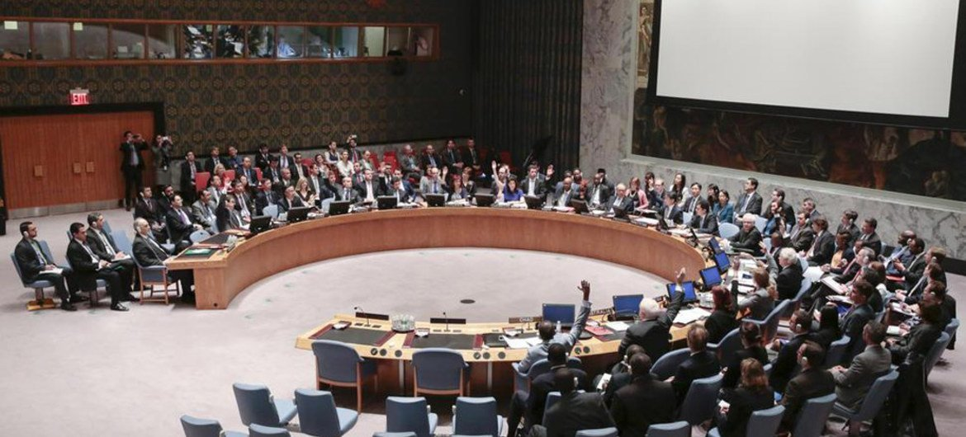
Who can refer a case to the International Criminal Court?
Various parties have the right to refer a case to the ICC:
any State Party to the Rome Statute, irrespective of any involvement in the alleged offence;
the Prosecutor of the ICC;
the United Nations Security Council
The United Nations Security Council may ask the ICC to defer investigation of a case for a limited period if it considers that the proceedings would constitute an obstruction to its powers.

Slide 8
Examples of situations currently under investigation by the ICC
Democratic Republic of the Congo
Situation referred to the ICC by the DRC Government: April 2004
ICC investigations opened: June 2004
Current focus:Alleged war crimes and crimes against humanity committed in the context of armed conflict in the DRC since 1 July 2002 (when the Rome Statute entered into force)
Current regional focus: Eastern DRC, in the Ituri region and the North and South Kivu Provinces

Slide 9
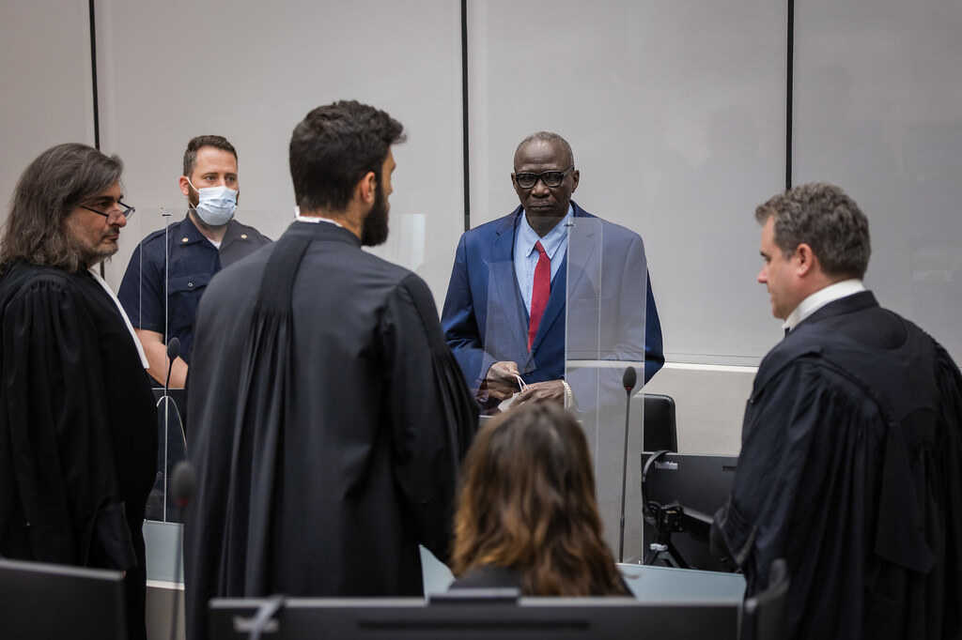
Darfur, Sudan
Situation referred to the ICC by the United Nations Security Council: March 2005
ICC investigations opened: June 2005
Current focus: Alleged genocide, war crimes and crimes against humanity committed in in Darfur, Sudan, since 1 July 2002 (when the Rome Statute entered into force)
Current regional focus: Darfur (Sudan), with Outreach to refugees in Eastern Chad and those in exile throughout Europe

Slide 10
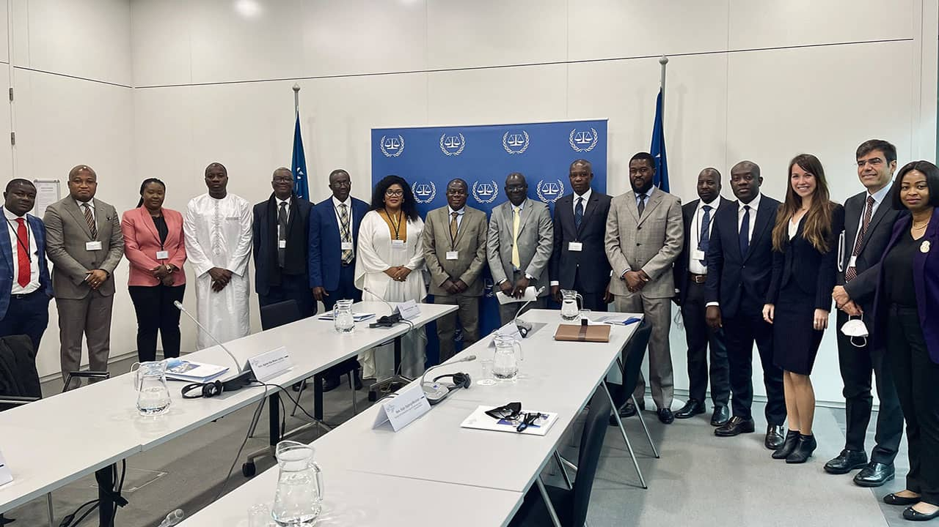
Uganda
Situation referred to the ICC by the Government of Uganda: January 2004
ICC investigations opened: July 2004
Current focus: Alleged war crimes and crimes against humanity committed in the context of a conflict between the Lord's Resistance Army (LRA) and the national authorities in Uganda since 1 July 2002 (when the Rome Statute entered into force)
Current regional focus: Northern Uganda

Slide 11
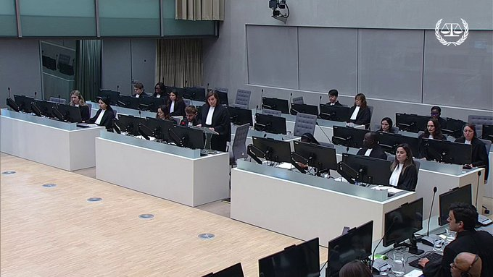
Central African Republic
Situation referred to the ICC by the CAR Government: December 2004
ICC investigations opened: May 2007
Current focus: Alleged war crimes and crimes against humanity committed in the context of a conflict in CAR since 1 July 2002, with the peak of violence in 2002 and 2003. (See CAR II for the situation in CAR from 2012 onward.)
Current regional focus: Throughout CAR

Slide 12
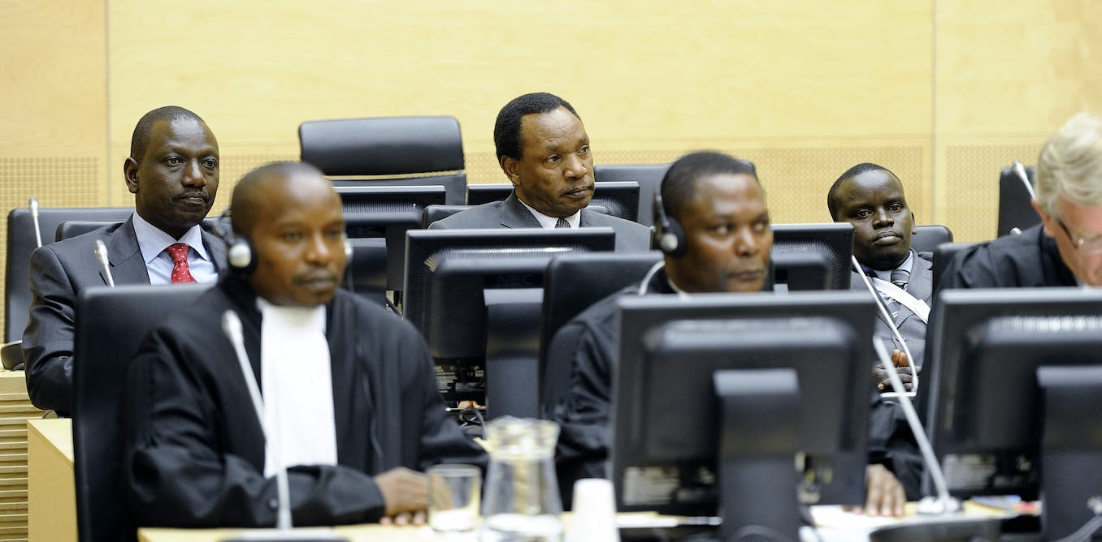
Kenya
ICC Prosecutor opens proprio motu investigation: March 2010
Current focus: Alleged crimes against humanity committed in the context of post-election violence in Kenya in 2007/2008.
Current regional focus: Six of the eight Kenyan Provinces: Nairobi, North Rift Valley, Central Rift Valley, South Rift Valley, Nyanza Province and Western Province

Slide 13
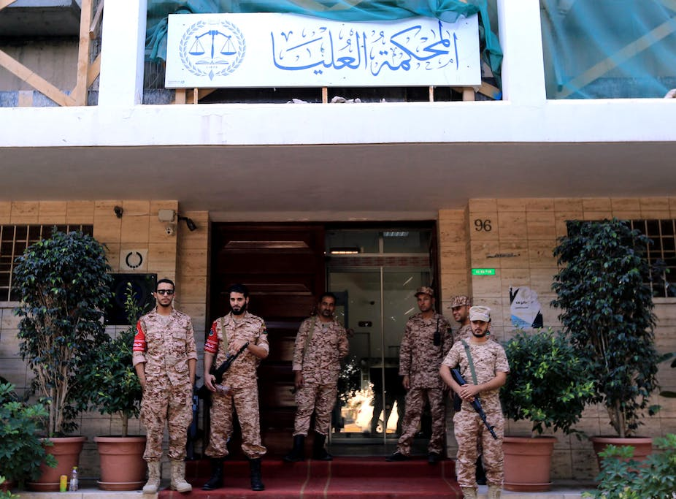
Libya
Situation referred to the ICC by the United Nations Security Council: February 2011
ICC investigations opened: March 2011
Current focus: Alleged crimes against humanity and war crimes committed in the context of the situation in Libya since 15 February 2011
Current regional focus: Throughout Libya in, inter alia, Tripoli, Benghazi, and Misrata

Slide 14
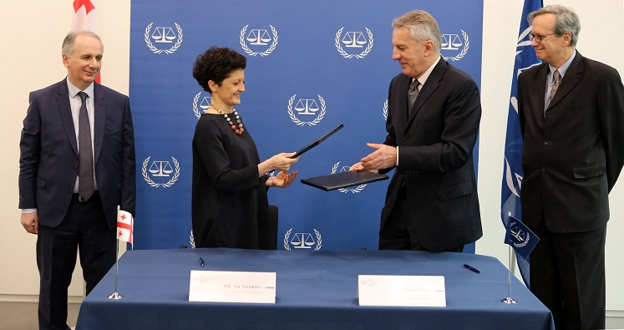
Georgia
ICC Prosecutor authorized to open proprio motu investigation: 27 January 2016
Current focus: Alleged crimes against humanity and war crimes committed in the context of an international armed conflict between 1 July and 10 October 2008
Current regional focus: According to the Prosecution's request for authorization to investigate: in and around South Ossetia

Slide 15
Sources:
Dutch ministry of social affairs
https://www.government.nl
International criminal court
https://www.icc-cpi.int

