Slide 1
Human rights in Iceland
Play for human rights - Iceland

Slide 2
History of human rights in Iceland
Slavery was widespread when the first settlers arrived but mostly disappeared after 1117. It was not banned by law until 1888
Discussions about human rights became common in the 19th century, when some countries put forth constitutions which included fundamental human rights
Iceland’s constitution was established in 1944 and includes many laws that put forth and protect people’s human rights
Just as in many other countries, the rights of groups like women, LGBTQ+, the elderly and disabled, immigrants and refugees have formed and taken changes since the 20th century, although they have not reached adequate levels in many aspects

Slide 3
What international laws and policies on human rights apply in Iceland?
Iceland is a treaty member to the Council of Europe and a member of the UN, with the most comprehensive laws and policies on human rights coming from there
The Convention on Human Rights of the Council of Europe applies as local law in Iceland and the council has the power to intervene if the state does not abide by them
Iceland agrees to and has put in place numerous policies and agreements of the UN, the primary one being the Universal Declaration of Human Rights

Slide 4
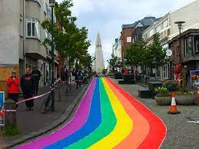
LGBTQ+ rights
A law that prohibited homosexuality and same-sex relationships was repealed in 1940, but members of the LGBTQ+ community were still treated unjustly by society for many decades after
In 1996, registered partnerships between same-sex couples were made legal. The same year, sexual orientation was added to the non-discrimination laws
In 2006, same-sex couples became eligible for insemination treatment and adoption of children
Jóhanna Sigurðardóttir became one of the world’s first openly gay prime-ministers in 2009
A legislation allowing same-sex couples to marry was passed by Alþingi on 27 June 2010 and took effect the same day

Slide 5
On 27 June 2012, gender reassignment surgery was allowed, but people had to complete a long and extensive medical examination.
The Church of Iceland allowed marriage between same-sex couples in 2015.
On 1 September 2018, a law banning employment discrimination based on sexual orientation and identity was passed
As of 1 January 2022, gay and bisexual men can legally donate blood.
Polls in Iceland show that the majority of the population supports the rights of LGBTQ+ members to, for example, adopt
The LGBT social network ranks Iceland as one of the highest on the Gay happiness index (GHI)
Discrimination is, however, never far away in society and violence, harassment and hate-speech are not uncommon

Slide 6
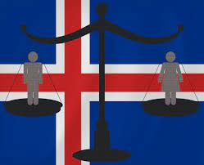
Gender equality and women’s rights
Despite Iceland being consistently ranked as one of the best places for women’s rights, gender equality has not yet been fully reached
For centuries, women did not have many rights but were legally in charge of the home and finances
In 1915, women were given the right to vote
Around the mid 20th century, women started receiving higher levels of education and now make up the majority of university graduates
Around that time, women also started making up more of the work market and now

Slide 7
Iceland elected its first female president, Vigdís Finnbogadóttir, in 1980
Jóhanna Sigurðardóttir became Iceland’s first female prime minister in 2009
The #metoo movement has been very widespread in Iceland and has brought to light countless stories of violence and abuse
Sexual harassment, violence and domestic abuse are still very prominent, with a 2018 study showing one in four women has been raped or sexually assaulted
Gender equality has also not yet been reached, with there being a substantial pay gap between men and women working the same jobs, and men often receiving preferential treatment in regards to employment

Slide 8
Laws enforcing Gender equality
There are many rules and policies in place that aim at providing equal possibilites for people to use their own will and strength however they desire, regardless of gender
These aims and policies include:
Working to achieve equal influence from men and women in society
Improving women’s position in society and increasing their possibilities
Working against pay gaps and other discrimination in regards to gender
Increasing information, education and research on equality
Working against gender based violence
Working to eliminate negative standards on the roles of men and women in society and on the work market
Protecting the rights people of unspecific genders especially

Slide 9
Treatment of immigrants and refugees
The number of immigrants in Iceland increases every year
The reasons for asylum seeking are numerous. Some seek asylum due to food shortages, others due to poor economic situations and others due to armed conflict.
Iceland recognizes that applying for asylum and getting refuge from persecution is a human right under the Universal Declaration of Human Rights, Article 14(1)
In 2020, Iceland reported 654 registered asylum-seekers, which is a decrease compared to the two previous years, the majority coming from the Palestine territories, Iraq and Venezuela.
In 2022, over 600 refugees have come from Ukraine alone
Refugees and immigrants often end up getting exploited by employers due to lack of information about their rights

Slide 10
Iceland is a member of two agreements in Europe, the Nordic Convention and the Dublin Regulation, which can be used to send asylum seekers back to the countries where they previously applied for asylum or to the countries from which they came before their journey to Iceland
It is not possible to go directly to Iceland from most of the countries where people have to live with wars and persecution and therefore it is often necessary to go through another country in the Schengen area
As a result, many people end up being deported to another country in Europe
Deportations in some instances take place after an individual has spent a significant amount of time in the country
Many are kept in inhumane conditions in deportation-centers where they have no contact with the outside world
Many are treated with violence and force by police
The Icelandic government is bound by the United Nations Convention Relating to the Status of Refugees and international human rights conventions that prohibit deportation to a country where the lives of individuals are endangered or people are at risk of persecution.

Slide 11
Treatment of the disabled and elderly
Iceland follows the United Nations Agreement on the rights of disabled people which among other things ensures that people can keep their independence and receive equal opportunities and prohibits discrimination
Öryrkjabandalag Íslands (ÖBÍ) was founded in 1961 to protect the rights and interests of disabled people in Iceland
Many say laws protecting the disabled are not enforced well enough, with disabled people making up a big part of the poor population
Sevices for disabled people, such as ramps and elevators are not at all adequate and many are forced out of education and carreer paths due to lack of accessibility
Landssamband eldri borgara (LEB) protects the rights of elderly citizens and, among other things, laws that ensure proper services and treatment of the elderly

Slide 12
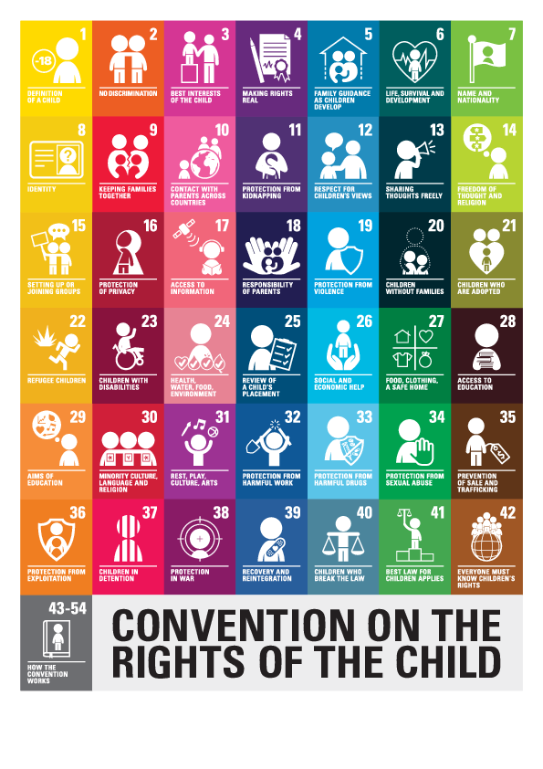
Children’s rights
Iceland agrees to the UN’s Convention on the Rights of the Child which ensures 54 fundamental rights for children
Icelandic laws state that children who live in difficult conditions should receive proper help and attention
Iceland pledges that all children should be seen as equal and recieve fair and equal opportunities
Icelandic laws state that every child has the right and is required to receive basic education and is entitled to higher levels of education

Slide 13
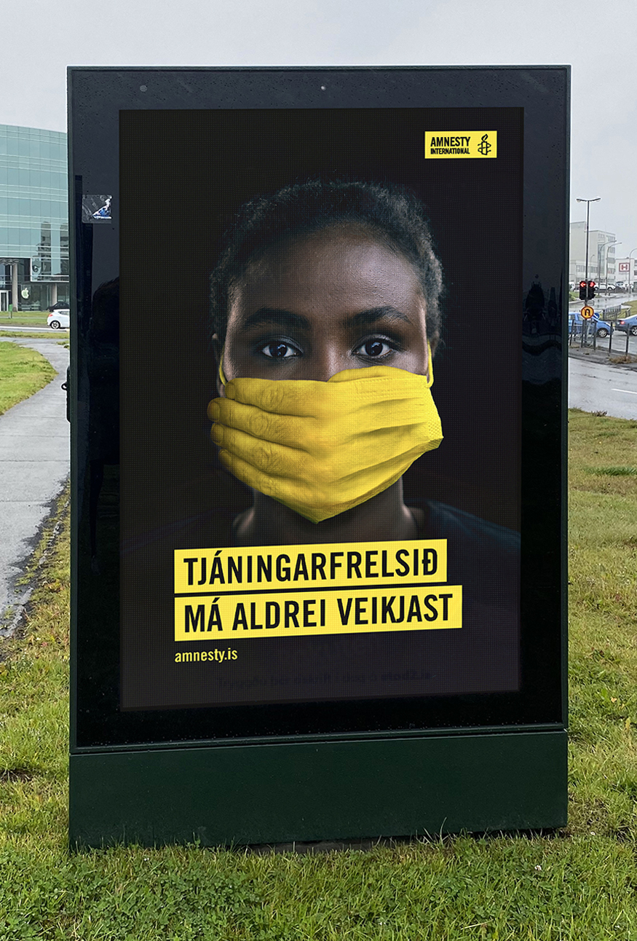
Freedom of speech
Article 73 of Iceland’s constitution states that everyone can express their thoughts as they desire, but must take responsibility for them before the law
The constitution prohibits laws and government actions that censor or limit free speech in an unjust way
The constitution permits restrictions on free speech when someone advocates for a foreign nation to interfere in internal affairs or poses a threat to state security and democracy
The way these laws are used is sometimes considered to infringe on international laws policies, such as the Universal Declaration of Human Rights
Openly insulting or otherwise disrespecting an established religion is considered illegal and can be met with jail-time

Slide 14
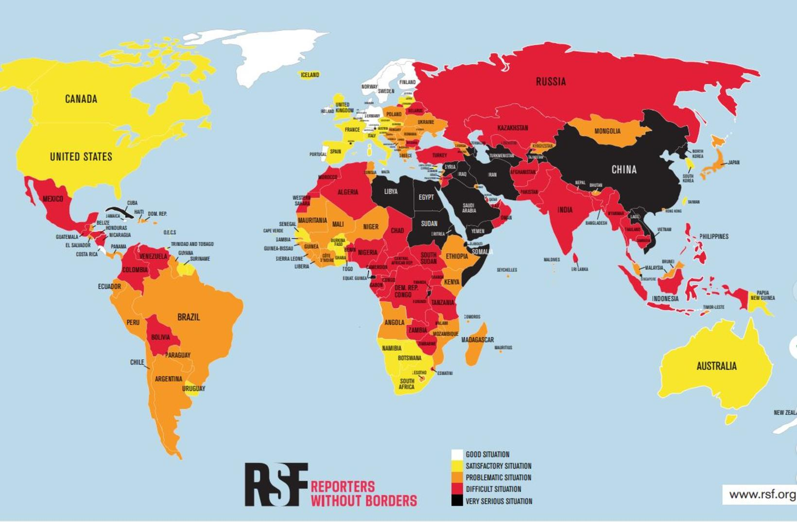
Freedom of press
Freedom of press is considered one of the most prominent flaws in Iceland’s human rights policies
In 2021, Iceland ranked 16th in the world on the World Press Freedom Index. This shows a steady decline since 2017, when Iceland was ranked 10th in the world
Iceland ranks considerably lower than many of its neighboring countries like Norway, Sweden and Denmark when it comes to freedom of press
Companies often spend time and money to harass and silence journalists if they report on their questionable business practices

Slide 15
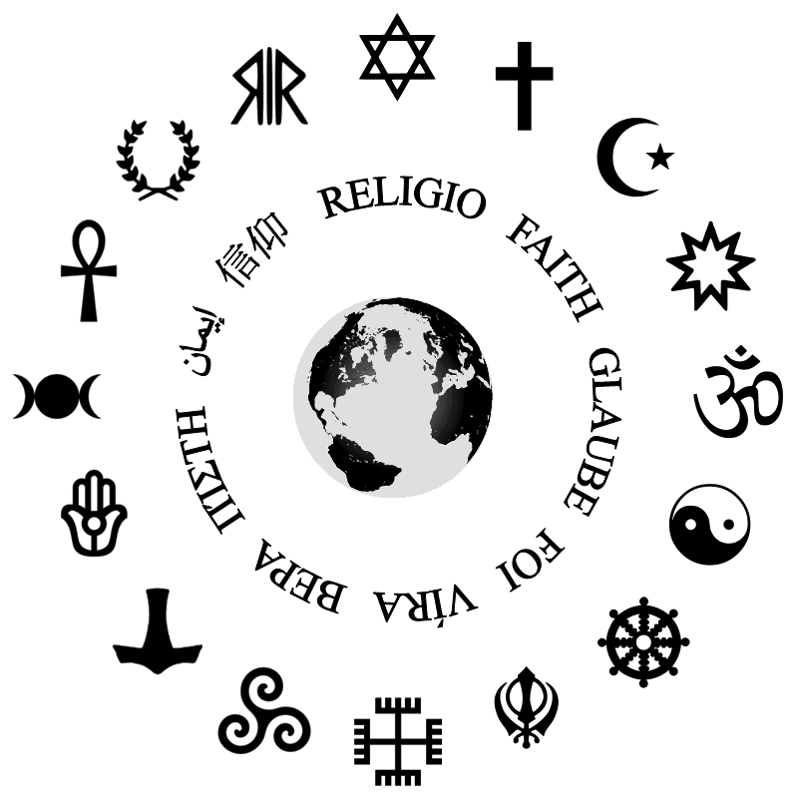
Freedom of religion
Iceland is concidered to have full freedom of religion
Iceland’s constitution maintains the right of an individual to practice any religion they want as long as it does not interfere with public order or common morals
The constitution prohibits insulting or disrespecting an established religion in the country
The constitution also protects the right to form religious organizations
Violence, hate-speech and discrimination against religious minorities such as people who practice Islam is not uncommon

Slide 16
State punishment
Icelandic laws prohibit the state from arresting or infringing on an an individual’s freedom unless certain requirements are met or if it’s in order to protect the public (such as during the Covid-19 pandemic)
Capital punishment has not been practiced in Iceland since 1830
Torture is prohibited in Iceland by numerous laws and international agreements, such as the UN and the Council of Europe
In January 2021, Iceland’s incarceration rate was around 38 per 100.000 people
The maximum prison sentence is usually around 16 years, with the longest one ever carried out being 20 years
The Icelandic prison system pledges to ensure prisoners have a secure and well organized serving of their sentences, to maintain humane and respectful communication and provide conditions and an environment in which prisoners are encouraged to deal with their circumstances

Slide 17
Where could things improve?
Discrimination and violence against member of the LGBTQ+ community is still widespread
Although Iceland is considered one of the most gender equal places in the world, there is still a lot more that needs to be done
The treatment of refugees is in many cases inhumane is in need of drastic changes
Services for the disabled are not at all adequate and they do not receive equal opportunities to everyone else
Freedom of press in Iceland is not adequate

Slide 18
Useful videos and websites
A 10 minute documentary on human rights in Iceland:
https://www.youtube.com/watch?v=GIpaaz8YPwU
The website of Iceland’s Human Rights Centre:
https://www.humanrights.is/en
A website showing the 54 rights Iceland agrees to from the UN’s Conference on the Rights of the Child:
https://www.barnasattmali.is/en

