Slide 1
Universal Declaration of Human Rights

Slide 2
What Are Human Rights?
Human rights are rights inherent to all human beings, regardless of race, sex, nationality, ethnicity, language, religion, or any other status. Human rights include the right to life and liberty, freedom from slavery and torture, freedom of opinion and expression, the right to work and education, and many more. Everyone is entitled to these rights, without discrimination.
Source: https://www.un.org/

Slide 3
What Is the Universal Declaration of Human Rights?
The Universal Declaration of Human Rights is a document which states a list of rules and rights which every person is entitled to.
The Declaration was proclaimed by the United Nations General Assembly in Paris on 10 December 1948 (General Assembly resolution 217 A) as a common standard of achievements for all peoples and all nations
Source: https://www.un.org/

Slide 4
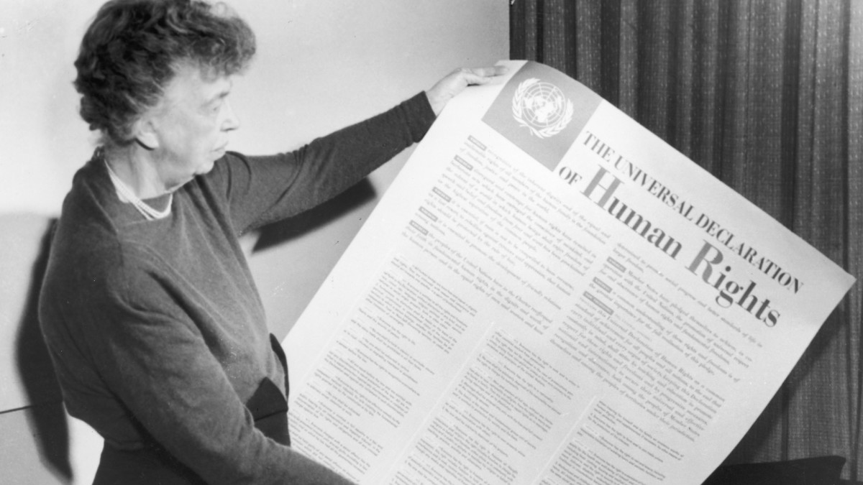
Women who shaped the Universal Declaration
Eleanor Roosevelt, the First Lady of the United States, wife of President Franklin Roosevelt, served as a U.S. delegate to the United Nations General Assembly, as well as the first Chairperson of the UN Human Rights Commission from 1946 to 1953. She was instrumental in drafting the Universal Declaration of Human Rights, presenting it to the General Assembly.
“We stand today at the threshold of a great event both in the life of the United Nations and the life of all mankind. This declaration may well become the international Magna Carta for all men everywhere.”
Source: https://www.un.org/

Slide 5
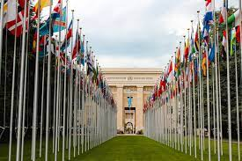
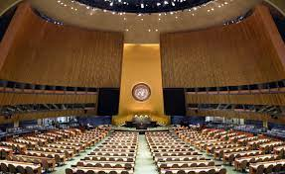
What is UN (United Nations)?
The United Nations is an international organization founded in 1945. Currently made up of 193 Member States, the UN and its work are guided by the purposes and principles contained in its founding Charter.
The UN has evolved over the years to keep pace with a rapidly changing world.
But one thing has stayed the same: it remains the one place on Earth where all the world’s nations can gather together, discuss common problems, and find shared solutions that benefit all of humanity.
Source: https://www.un.org/

Slide 6
Article of Universal Declaration of Human Rights
Article 1
Free and equal
Article 3
Right to life
Article 5
Freedom from torture
Article 2
Freedom from discrimination
Article 4
Freedom from slavery
Article 8
Access to justice
Article 9
Freedom from arbitrary detention
Article 6
Right to recognition before the law
Article 10
Right to a fair trial
Article 7
Right to equality before the law
Article 13
Freedom of movement
Article 14
Right to asylum
Article 11
Presumption of innocence
Article 15
Right to nationality
Article 12
Right to privacy

Slide 7
Article of Universal Declaration of Human Rights
Article 16
Right to marriage and to found a family
Article 18
Freedom of religion or belief
Article 17
Right to own property
Article 19
Freedom of Expression
Article 20
Freedom of assembly
Article 23
Right to work
Article 21
Right to partake in public affairs
Article 24
Right to leisure and rest
Article 25
Right to adequate standard of living
Article 22
Right to social security
Article 28
Right to a free and fair world
Article 29
Duty to your community
Article 27
Right to take part in cultural, artistic and scientific life
Article 30
Rights are inalienable
Article 26
Right to education

Slide 8
I can identify human rights
I can identify the importance of the Universal Declaration of Human Rights

